Slide 1





S&P 500 + Popular Stocks: Daily Trends & % Change

Slide 2
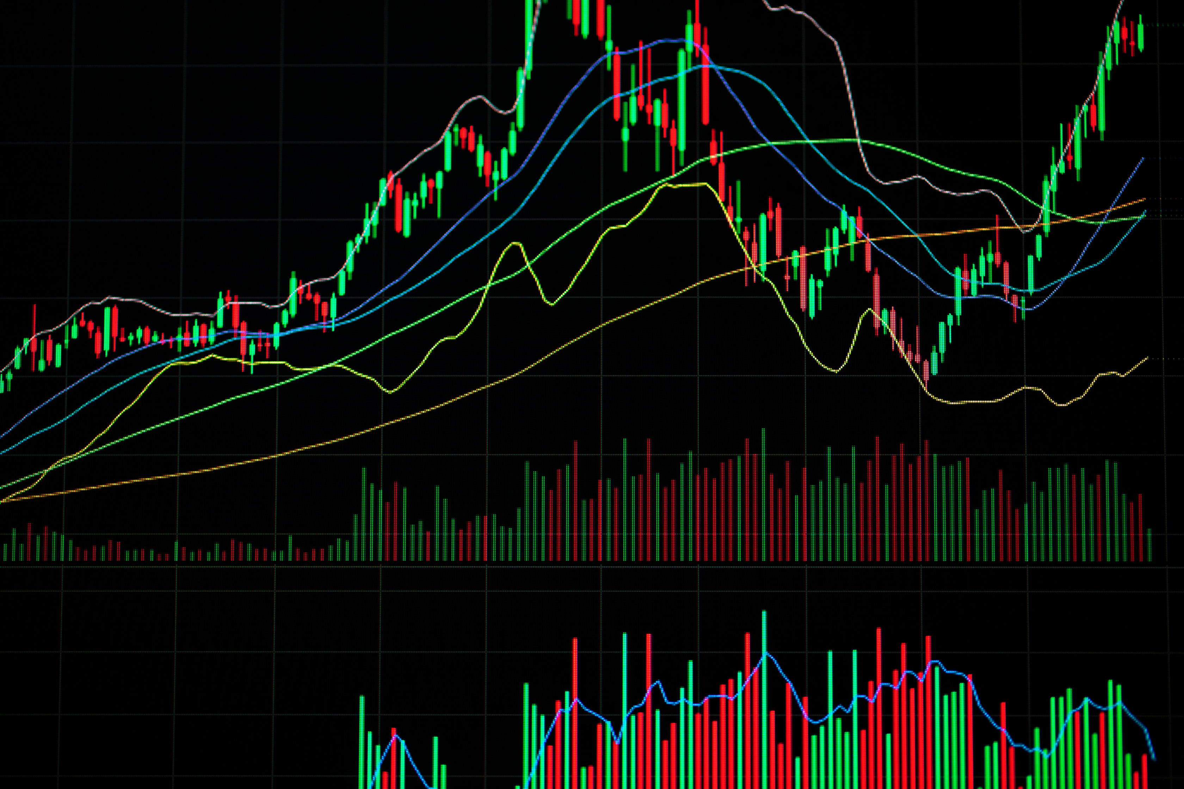

S&P 500 + Popular Stocks: Daily Trends & % Change
The S&P 500 Popular Stocks Daily Trends and Change dataset The S&P 500 Popular Stocks Daily Trends and Change dataset provides daily data on trends and price changes of companies in the S&P 500 index. It includes stock prices (open, close, high, low), trading volume, daily percentage changes, market sentiment, stock tickers, and industry sectors. This dataset is useful for tracking stock performance, analyzing market trends, and predicting stock prices based on historical data.

Slide 3

companies included in the data
This dataset encompasses daily data from 2012 to 2021, with some missing days. However, there is no null data present. The dataset includes stock data for companies such as ADBE, INTC, MSFT, AMD, NVDA, DIS, NFLX, TSLA, META, and KFC.

Slide 4
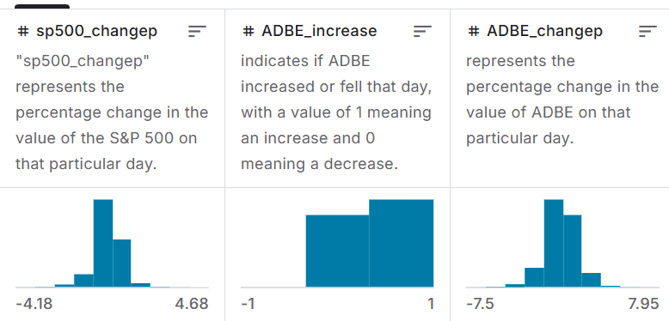
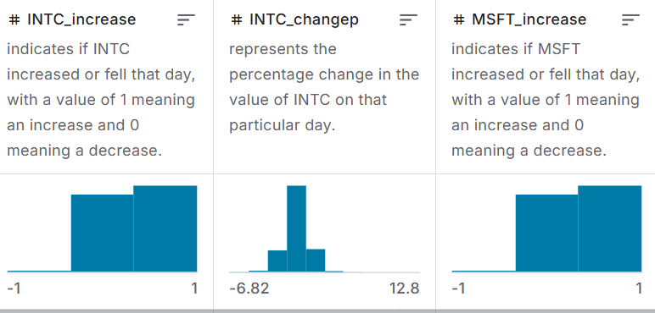
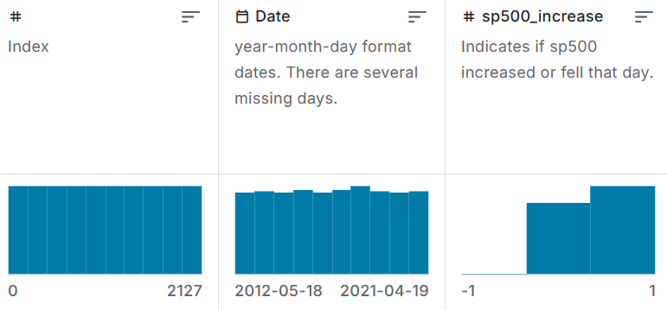
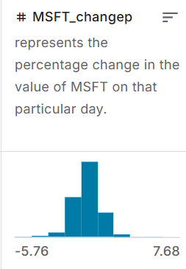
Detail

Slide 5

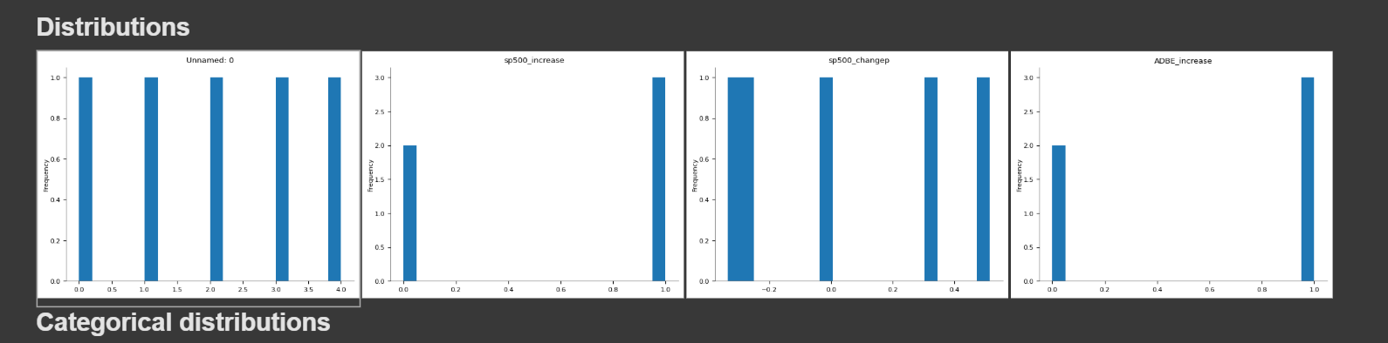
Distrobutions

Slide 6
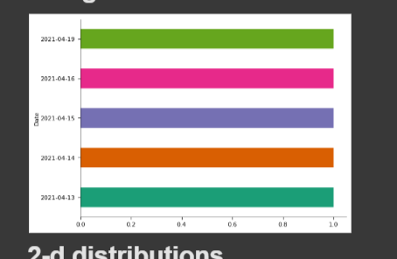
Categorical distributions

Slide 7
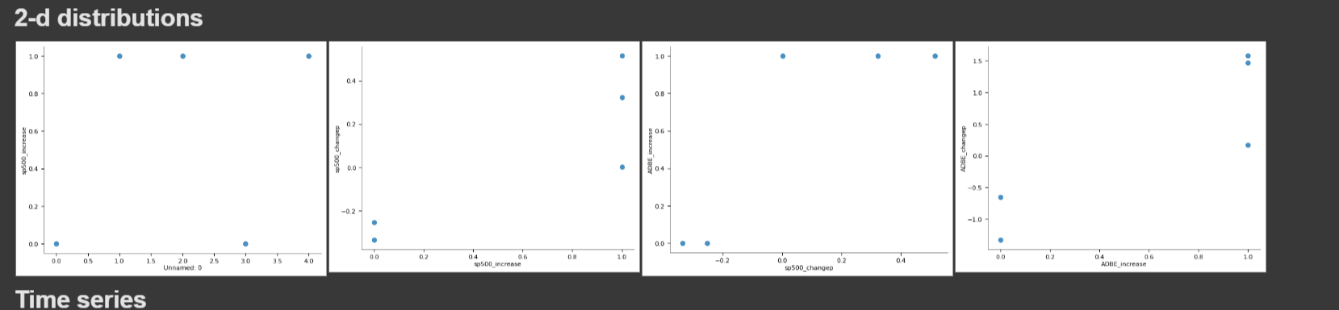
2-d distributions

Slide 8
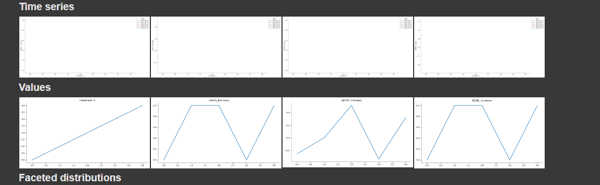
Time series and Values

Slide 9
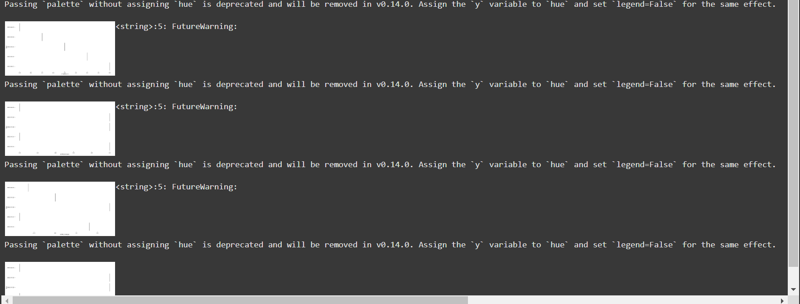
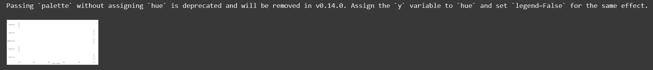
Faceted distributions

Slide 10



Thank
You
Astrid Kusumaningtyas
astridktyas12@gmail.com
astyas1

